Slide 1
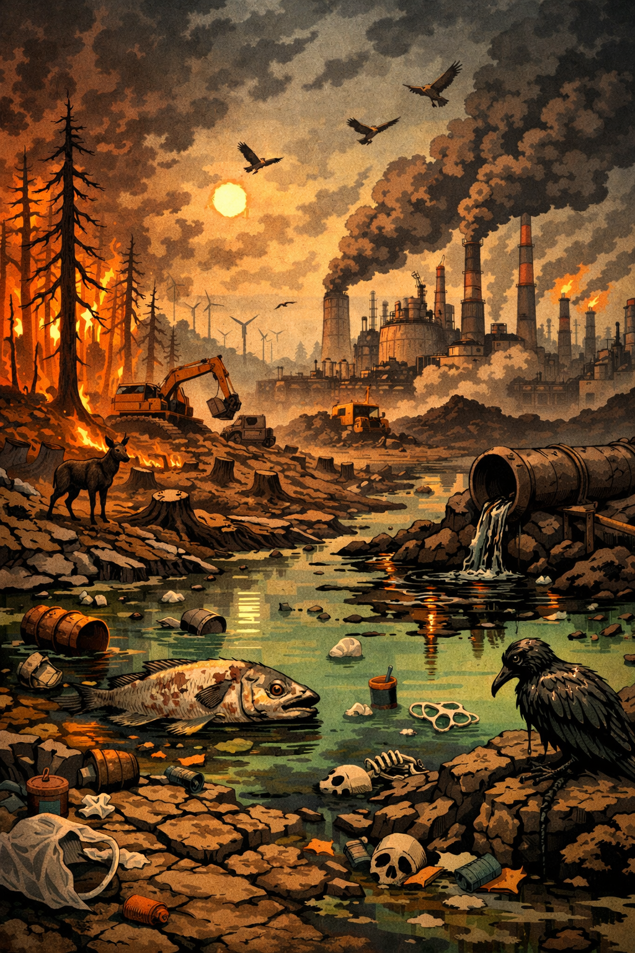

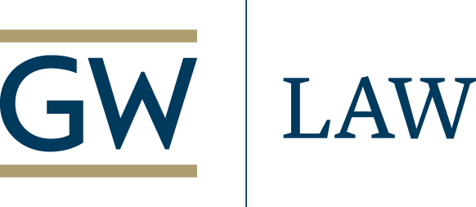
The Unraveling of Environmental Law
Spring 2026 Distinguished Lecture
Florida State University College of Law
February 11, 2026
Robert L. Glicksman
J.B. & Maurice C. Shapiro Professor of
Environmental Law
The George Washington University Law School

Slide 2

Road Map
The Origins and Defining Features of U.S. Environmental Law
Favorable Institutional Dynamics
Core Values
Key Implementation Processes
Core Substantive Commitments
The Unraveling of U.S. Environmental Law
Dysfunctional Institutional Dynamics
Disavowal of Core Values
Dismantling of Key Implementation Processes
Abandonment of Core Substantive Commitments
Saving Environmental Law

Slide 3

Favorable Institutional Dynamics
Bipartisan political support
Congress
Executive branch officials
Buy-in from the federal judiciary
Cooperative federalism

Slide 4
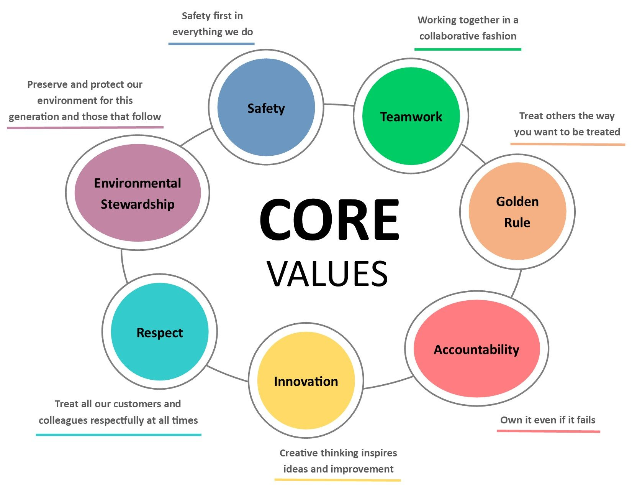
Core Values
Precautionary action
Faith in science
Pluralism and equity
Transparency and accountability
The “polluter pays”

Slide 5
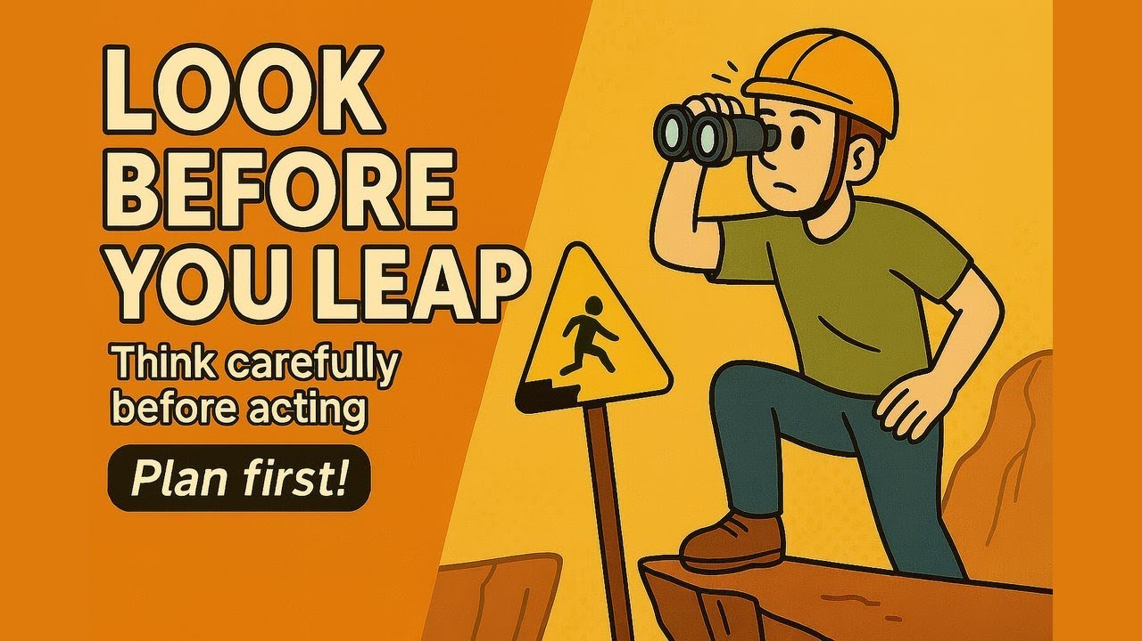
Key Implementation Processes
Environmental impact assessment (look before you leap)
Meaningful public participation (democracy enhancement)
Planning (avoid scattershot decisionmaking)

Slide 6

Core Substantive Building Blocks
Preservation of public lands and resources
Protection of the public health
Err on the side of overprotection
Increase levels of protection over time
Best available technology

Slide 7

The Unraveling of Environmental Law

Slide 8



Unfavorable Institutional Dynamics
Fractured political support
Congress
Executive branch officials
A skeptical if not hostile federal judiciary
One-way federalism
The Feds
State environmental regulation

Slide 9


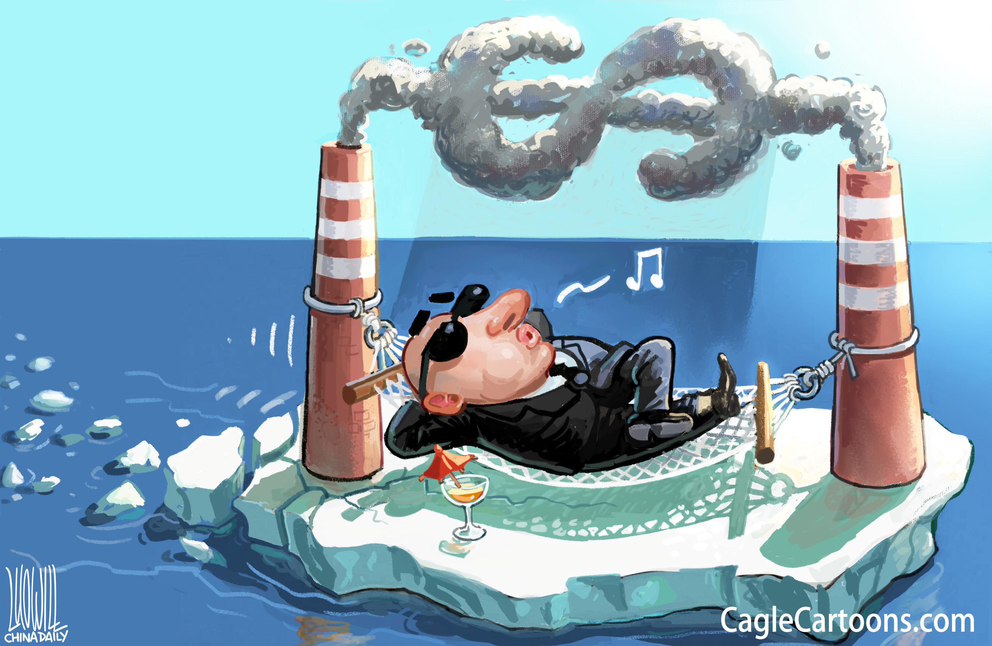

Denigration of Core Values
Abandonment of precaution
Science doesn’t matter
No DEI
Secrecy and lack of accountability
The public, not the polluter, pays

Slide 10

Hollowed Out Implementation Processes
Avoid environmental impact assessment (proceed in ignorance whenever possible)
Preclude public participation (democracy erosion; who cares?)
Haphazard and ill-considered decisionmaking (end-result orientation)

Slide 11


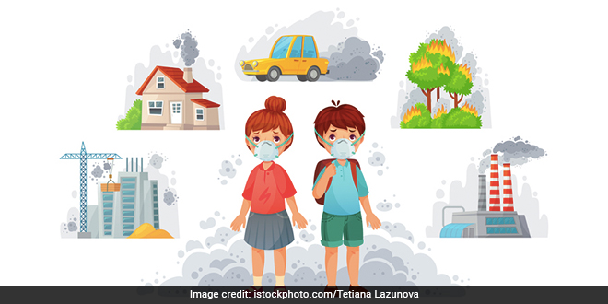
A Crumbling Substantive Foundation
Sacrifice the public health
Err on the side of underprotection
Weaken protections over time
Compliance cost is all that matters
Maximum exploitation of public lands and resources (Energy dominance!!! But only fossil fuels)

Slide 12
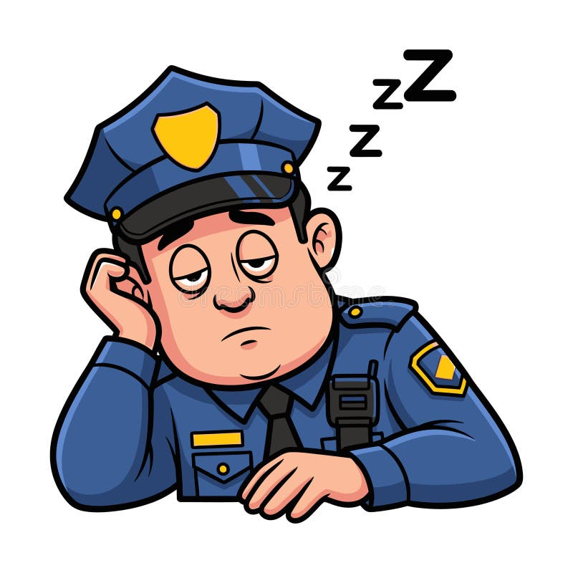

The Elimination of Credible Enforcement Threats

Slide 13
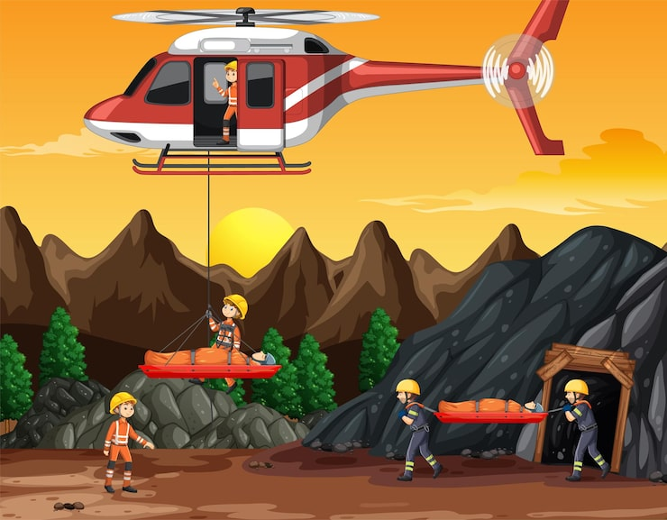
Saving Environmental Law
Public participation
Communication
Countering false narratives
and bombastic messaging
Voting for environmental
protection proponents
Pursuing state and local
protective actions
Engagement and activism

